Slide 1
SWEPCO Texas Cities
2020 Base Rate Overview
October 21, 2020

Slide 2
2020 Texas Base Rate Case Overview
Request for a net annual increase of $90.2 million in non-fuel base rates
Net increase is approximately 15.6% on total customer bill basis
If approved, new rates likely go into effect first billing cycle January 2022
However, new rates will relate back to April 2021

Slide 3
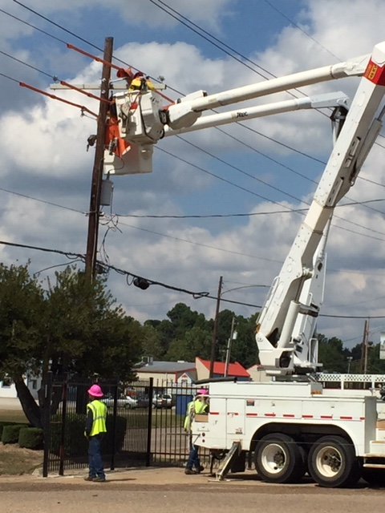
2020 Texas Base Rate Case Overview
Investments in Generation, Transmission, and Distribution systems to benefit customers for years to come
Transmission investments for refurbishment, expansion, and reliability
Distribution investments for grid modernization and reliability
Generation investment for availability and reliability

Slide 4
2020 Texas Base Rate Case New Initiatives
Electric vehicle charging time of use tariff
Residential all home time of use tariff
Commercial and industrial time of use tariff
LED lighting tariffs
Expansion of economic development tariff
Existing option (500 kw new or increased load)
New Option (200 kw new or increased load)
3 year demand rate discount
Threshold for increase in employment
Storm reserve

Slide 5
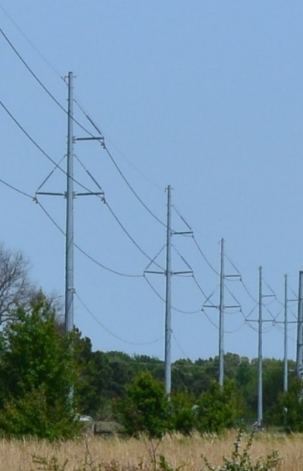
2020 Texas Base Rate Case Key Drivers
SWEPCO’s request includes:
Investments in generation, transmission and distribution facilities since 2016, plus increased O&M costs to provide reliable and safe service to Texas customers
Additional vegetation management
Costs related to generating unit retirements
Increased tax costs related to accelerated depreciation
Existing TCRF and DCRF moved into base rates

Slide 6
2020 Texas Base Rate Case Plant Retirement - Dolet Hills
Dolet Hills Power Station will be retired by end of 2021
Two steps to lessen rate impact of remaining undepreciated value of plant:
Offset part of balance with funds set for refund to customers as a result of reduction in federal corporate income taxes
Depreciate the remaining balance over a four-year period

Slide 7
2020 Texas Base Rate Plants Retirements – Natural Gas
Retired 5 units in 2019/2020 after more than 60 years of reliable service - Knox Lee 2, 3, 4 (140 MW); Lieberman 2 (26 MW); Lone Star 1 (50 MW)
Knox Lee 5 (342 MW) and Lieberman 3 and 4 (217 MW) continue operations

Slide 8
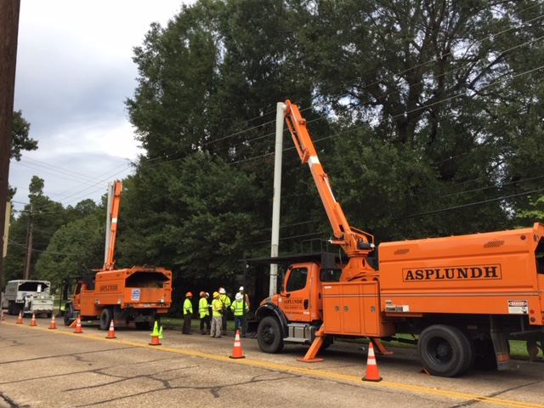
2020 Texas Base Rate Case Vegetation Management
Requesting additional $5 million annually for expanded program to reduce tree-related outages
Critical to maintaining distribution system reliability
Will improve reliability on targeted circuits as demonstrated by the reduction in the number of tree-related outages on the Texas circuits that were trimmed in 2018 and 2019

Slide 9
2020 Texas Base Rate Case Vegetation Management
Circuits Trimmed in 2018
 | Twelve Months Ending December 2017 | Twelve Months Ending March 2020 | Difference | % Reduction
No. of Interruptions | 47 | 7 | 40 | 85%
Customers Affected | 1,334 | 53 | 1,281 | 96%
CMI | 248,308 | 7,572 | 240,736 | 97%
Circuits Trimmed in 2019
 | Twelve Months Ending December 2018 | Twelve Months Ending March 2020 | Difference | % Reduction
No. of Interruptions | 30 | 3 | 27 | 90%
Customers Affected | 4,452 | 24 | 4,428 | 99%
CMI | 730,148 | 5,728 | 724,420 | 99%

Slide 10
2020 Texas Base Rate Case Customer Impact
Major Rate Class Proposed Increase (Total Bill)
Residential 15.64%
Commercial 16.82%
Industrial 13.28%
Comm. & Ind. 15.90%
Municipal 5.84%
Lighting 10.57%

Slide 11
2020 Texas Base Rate Customer Impact
As proposed, residential customer using 1,000 kilowatt-hours per month would see a total bill increase of $15.71, or 15% per month (from $104.78 to $120.49).

Slide 12
2020 Texas Base Rate Case Improvement Investments
Transmission improvement investments
$636.7 million since last rate case*
Projects at Welsh DC tie, Valliant to NW Texarkana, Longview Heights, Evenside-NW Henderson
Distribution improvement investments
Ongoing inspection/repairs – poles, transformers, conductor, switchgear, other equipment
$143.5 million since last rate case *
Generation improvements
Projects to improve unit availability and efficiency and minimize environmental impact
Includes Pirkey Plant control system replacements and upgrades and Wilkes Plant major boiler projects
* Some T&D investments included in current TCRF/DCRF

Slide 13
2020 Texas Base Rate Review Next Steps
Cities to take action by November 17, 2020:
cede original jurisdiction to the Commission;
deny SWEPCO’s request;
grant SWEPCO’s request in whole or part; or
“suspend” SWEPCO’s requested change in rates for an additional 90 days (a total of 125 days) before taking final action.
SWEPCO action after November 17, 2020:
SWEPCO will appeal that action to the Commission, which has the authority to make the final decision on the rate change request.

Slide 14
Questions ?
Jennifer Harland
903736-3389

